Slide 1
Java with database Connectivity (JDBC and ORM)

Slide 2
JDBC Java™ EE Database Connectivity

Slide 3
What is JDBC Driver?
A JDBC driver is a software component enabling a Java application to interact with a database server.
For example, using JDBC drivers enable you to open database connections and to interact with it by sending SQL or database commands then receiving results with Java.

Slide 4
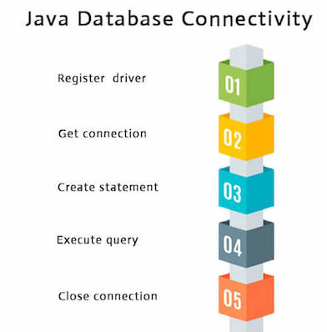

Slide 5
ORM Object Relational Mapping using Hibernate

Slide 6
JPA and hibernate
JPA stands for Java Persistence API (Application Programming Interface). It was initially released on 11 May 2006. It is a Java specification that gives some functionality and standard to ORM tools. It is used to examine, control, and persist data between Java objects and relational databases. It is observed as a standard technique for Object Relational Mapping.
JPA is only a specification, it is not an implementation.
Hibernate is an implementation of JPA guidelines.

Slide 7
Annotations
@Entity annotation marks this class as an entity.
@Table annotation specifies the table name where data of this entity is to be persisted. If you don't use @Table annotation, hibernate will use the class name as the table name by default.
@Column annotation specifies the details of the column for this property or field. If @Column annotation is not specified, property name will be used as the column name by default.
@Id annotation marks the identifier for this entity.

Slide 8
ID Generation
1- Auto
2- Identity
3- Sequnece
4- Table

Slide 9
Tables relation mapping
One-to-Many/Many-to-One
In the entity which have one
@ManyToOne @JoinColumn(name = "TEACHER_ID", referencedColumnName = "ID")
private Teacher teacher;
in the entity which have many
@OneToMany(mappedBy = "teacher")
private List<Course> courses;

Slide 10
Tables relation mapping
One-to-One
@OneToOne(optional = false) @JoinColumn(name = "COURSE_ID", referencedColumnName = "ID")
private Course course;
@OneToOne(mappedBy = "course")
private CourseMaterial material;

Slide 11
Tables relation mapping
Many-to-Many
@ManyToMany @JoinTable( name = "STUDENTS_COURSES", joinColumns = @JoinColumn(name = "COURSE_ID", referencedColumnName = "ID"), inverseJoinColumns = @JoinColumn(name = "STUDENT_ID", referencedColumnName = "ID") ) private List<Student> students;

Slide 12
Fetching types
1- egare
2- lazy
@OneToMany(mappedBy = "teacher", fetch = FetchType.EAGER) private List<Course> courses;

Slide 13
Using hibernate
1- create SessionFactory
2- get Session from SessionFactory
3- use Session for making transactions

Slide 14
Entity Life Cycle
Transient State
Persistent State
Detached State
Removed State

Slide 15

Transient State
The transient state is the first state of an entity object. When we instantiate an object of a POJO class using the new operator then the object is in the transient state. This object is not connected with any hibernate session. As it is not connected to any Hibernate Session, So this state is not connected to any database table. So, if we make any changes in the data of the POJO Class then the database table is not altered. Transient objects are independent of Hibernate, and they exist in the heap memory.

Slide 16
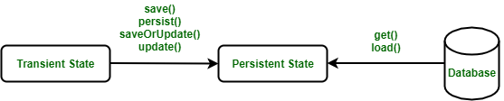
Persistent State
Once the object is connected with the Hibernate Session then the object moves into the Persistent State. So, there are two ways to convert the Transient State to the Persistent State :
Using the hibernated session, save the entity object into the database table.
Using the hibernated session, load the entity object into the database table.

Slide 17
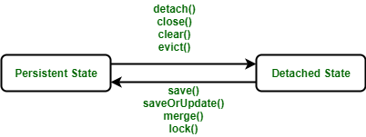
Detached State
For converting an object from Persistent State to Detached State, we either have to close the session or we have to clear its cache. As the session is closed here or the cache is cleared, then any changes made to the data will not affect the database table. Whenever needed, the detached object can be reconnected to a new hibernate session.

Slide 18
removed state
the removed state, when the entity object is deleted from the database then the entity object is known to be in the removed state. It is done by calling the delete() operation. As the entity object is in the removed state, if any change will be done in the data will not affect the database table.

Slide 19
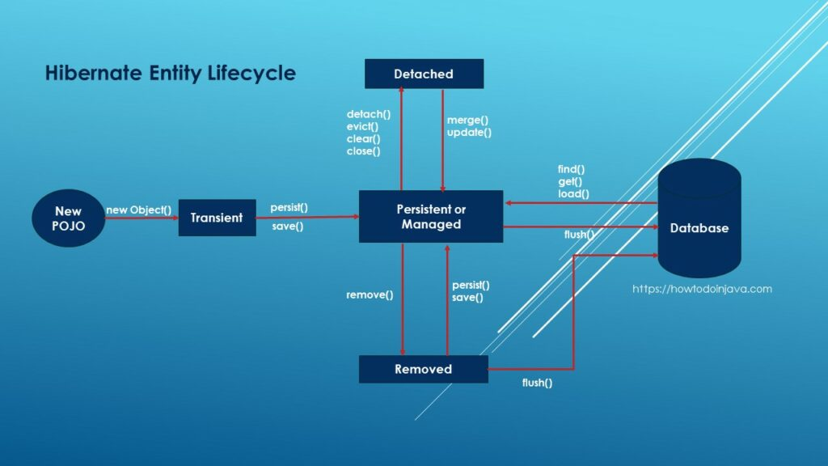
Entity life Cycle

Slide 20
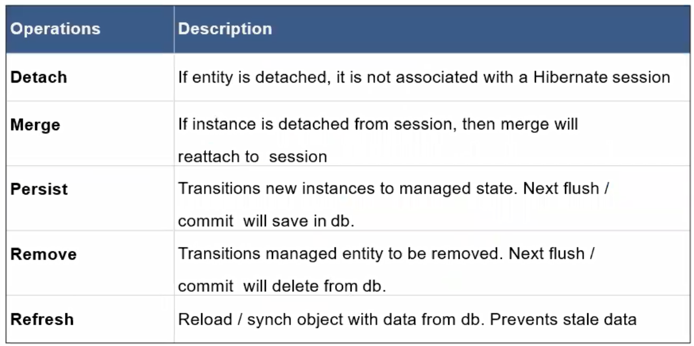
Session operation on entity

